Slide 1

Welcome to Year 3
July 2026
Ludlow Junior School

Slide 2






Our School Core Values
Our school is founded on a culture of mutual respect. We believe that for children to reach their full potential, they must feel happy, safe and secure at school. Adults across the school build warm and genuine relationships with pupils, modelling the positive behaviour we expect of all our children.

Slide 3
Expectations of behaviour
To ensure that everyone is safe, happy and able to learn, we have rules that all children must follow. Children consistently following the rules will be rewarded.
At school, we expect all children to:
follow teacher's instructions
be polite
try their best
focus on their learning
listen to one another
respect one another's feelings and belongings.

Slide 4
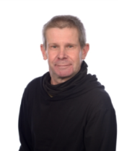
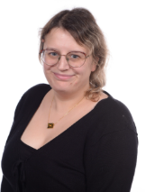
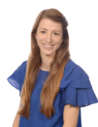
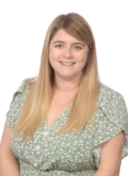
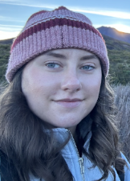
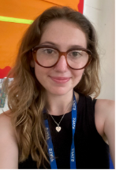
Meet the Year 3 team
Mrs McPhillimy (M,T) and
Mrs Ireland (W,T,F)
3 Avon
Heads of year
Mr Poucher
3 Trent
Miss Elliott
3 Thames
Miss Mannell
3 Stour
Miss Williams
3 Hamble

Slide 5
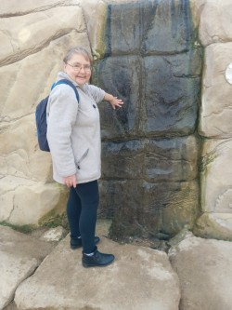
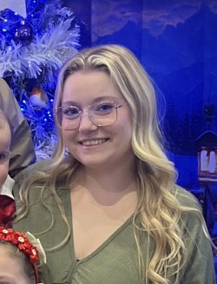
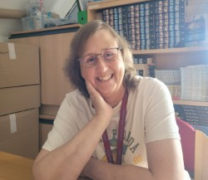
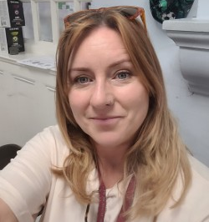
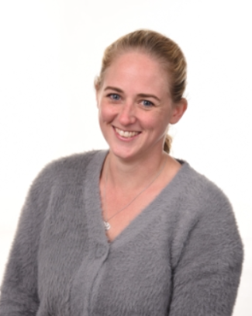
Meet the Year 3 team
Mrs Gerrard
Mrs Wilde
Miss Morgan
Mrs Mathieson
Mrs Vallis

Slide 6



Year 3 Curriculum
 | Autumn | Spring | Summer
English | The Firework-Makers’ daughter | Charlotte’s Web and The BFG | Matilda and Krindlekrax
Math | Addition and subtraction | Multiplication and division | Shapes, Time and Fractions
Science | Animals and Light | Rocks and Magnets | Plants
History and geography | Stone age to Iron age | The UK and my region | Egyptians
Here are just a few of the exciting topics we will cover next year.

Slide 7
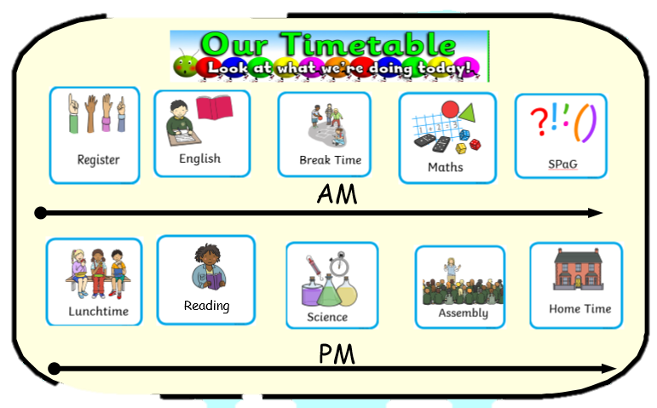
Year 3 timetable
Here is an example of what a day in year 3 might look like in September.
Time | Activity
8:40 | Gates open - straight into school for morning task
8:55 | Gates close
9:00 | Registers close
9:05 | English
10:10 | Break time
10:30 | Spelling, grammar, phonics
10:55 | Maths
12:00 | Lunch
12:55 | Afternoon register
1:00 | Reading and Number sense
1:30 | Afternoon lessons
3:25 | Home time
Parents can come onto the playground to drop off their child and collect them at the end of the school day.
Children should go straight into school when they arrive in the morning.

Slide 8
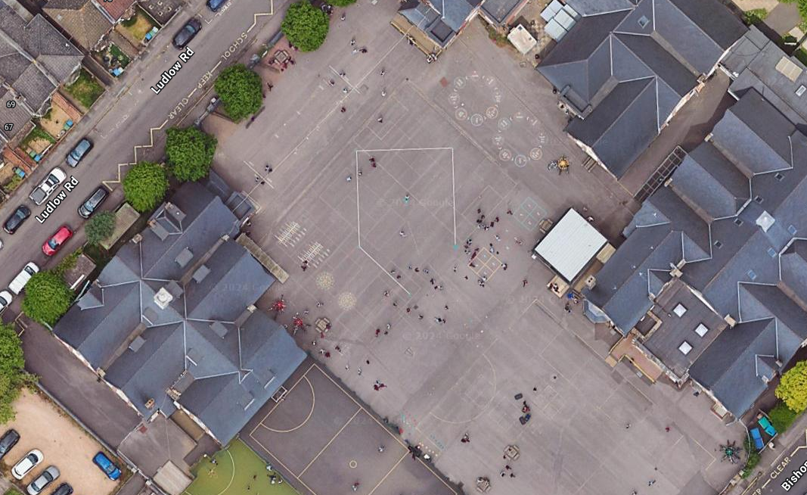



End of the day!
3 Avon
3 Stour
3 Hamble
A
3 Trent
B
3 Thames
C
D
E

Slide 9
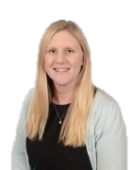
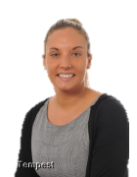
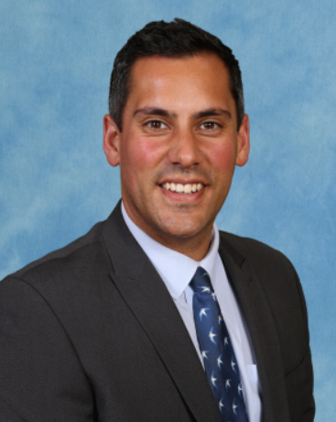


Meet the Senior Team
Mr O'Hearn
Executive Headteacher
Mrs Chandler
Deputy
Headteacher
Mrs Stevenson
Deputy
Headteacher
Mrs Hotston
Deputy Headteacher & SENDCo
Mr Palmer
Assistant Headteacher

Slide 10
LAPS rewards
Ludlow Academy Points System (LAPS) is our way of promoting positive behaviour at Ludlow Junior School. Pupils can earn LAPS points for attendance, work and behaviour. These points are recorded and can then be spent in the LAPS shop.
Sanctions
If a child’s behaviour needs to improve, they will receive a verbal warning. Following this warning, if the behaviour continues, they will miss 10 minutes of break. If it still does not improve, they will miss the whole of their break.

Slide 11

Weekly Home Learning
The children will bring home a home learning booklet which has their spellings, weekly reading home learning and space for their number sense scores for the week.
It is important that this booklet is brought into school each day as it is used to support learning in school.
Teachers will check whether children have done their home learning on a Friday and test them on spellings and times tables.
Children who regularly complete home learning to a high standard will be rewarded. Teachers will phone home when they are concerned that home learning is frequently not being completed.
Home learning day is a Friday.
Home learning covers:
1. Number sense
2. Spelling Lists
3. Reading
Your children will bring home a log in for Bug Club and TT Rockstars in September.

Slide 12
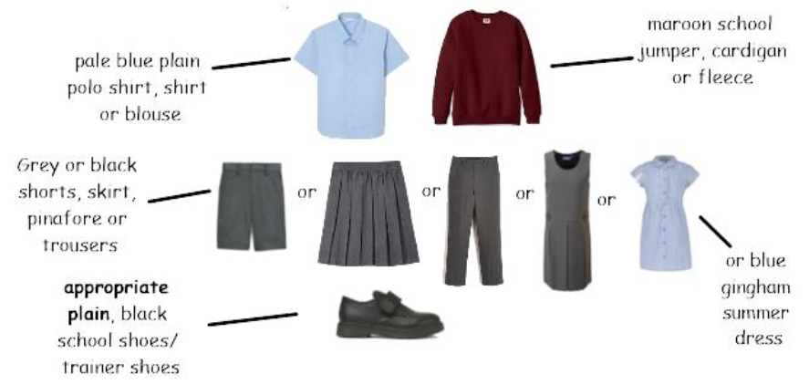
School Uniform
Children must attend school in their school uniform.
School uniform must consist of the above. You can purchase uniform with a logo on but plain uniform without a logo is also acceptable.
You can now order uniform from school. For more information, speak to Mr Grice-Hart in the hall afterwards.

Slide 13
School Uniform
Jewellery should not be worn apart from one pair of stud earrings.
Hair should not be brightly coloured. This includes extensions.
Pupils should not wear fake nails or nail varnish in school.
Children should not wear fake tattoos.

Slide 14
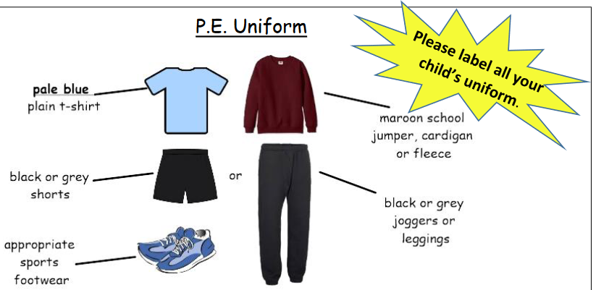
PE Uniform
On P.E. days, children must attend school in their P.E. uniform. No jewellery should be worn for P.E. including stud earnings. If stud earrings cannot be removed, they should be taped up provided from home. Long hair should be tied up away from the face for P.E. lessons.
When it is your child's day for PE or games, they come into school wearing their PE uniform.

Slide 15
Food at Ludlow
Our Catering team provide around 350 hot meals each day to our pupils. Meals include a choice of meat and vegetarian dishes, tomato pasta, bread options and jacket potato. There is also a salad bar with a variety of different options.
Once they have finished their hot meal, a variety of different puddings is on offer.
The kitchen team are fantastic at catering for individual medical and religious dietary needs including allergies and intolerances. (Contact school office)
The cost of a hot meal will cost £3.10 per day.
We encourage school meals to be booked and paid for on a Monday, for the week please, although meals can be ordered on the day providing the pupil account is in credit.
We encourage you to look at the menu with your child to support them choosing their favourites and to make good choices together, pre-ordering on ParentMail.
https://apply.cloudforedu.org.uk/ofsm/southampton/apply

Slide 16
Staying healthy
We ask that snacks that are brought into school for breaktime are healthy e.g. a piece of fruit.
We also ask that children bring in a named clear water bottle to keep hydrated during lessons. This must only be water and not squash, juice or carbonated drinks.
Water is available to be topped up during the day.

Slide 17
Clubs at Ludlow

Slide 18
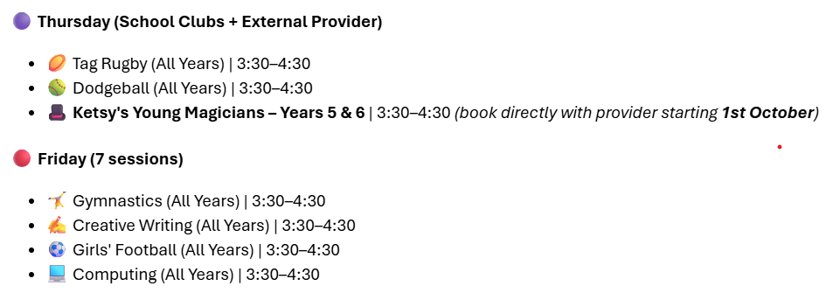
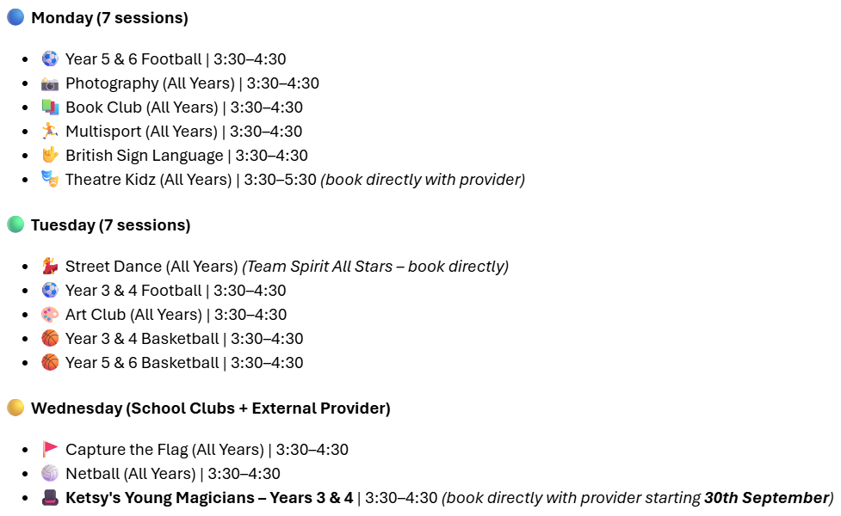
Clubs at Ludlow

Slide 19
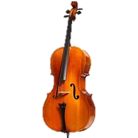
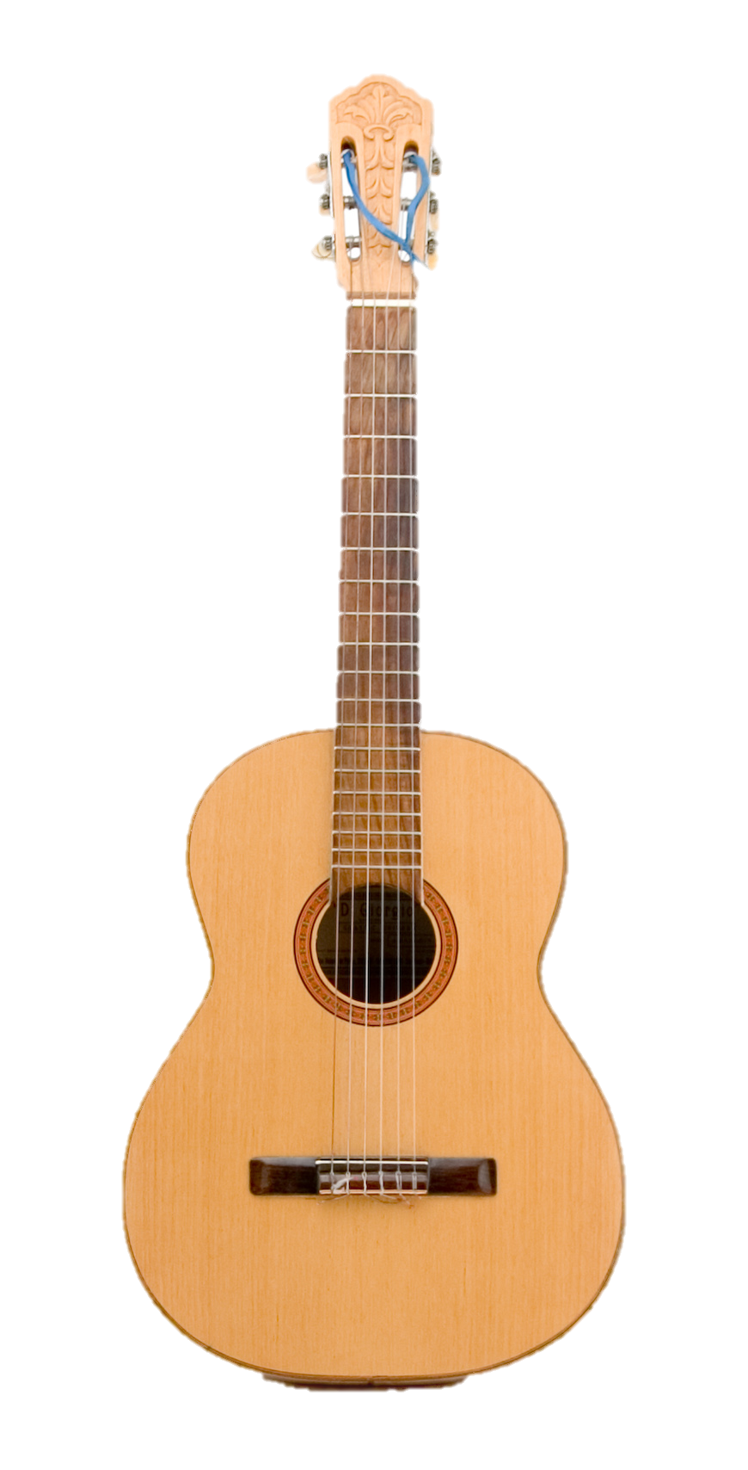
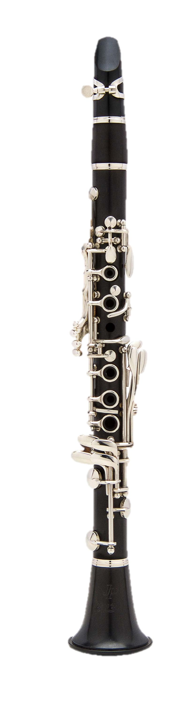
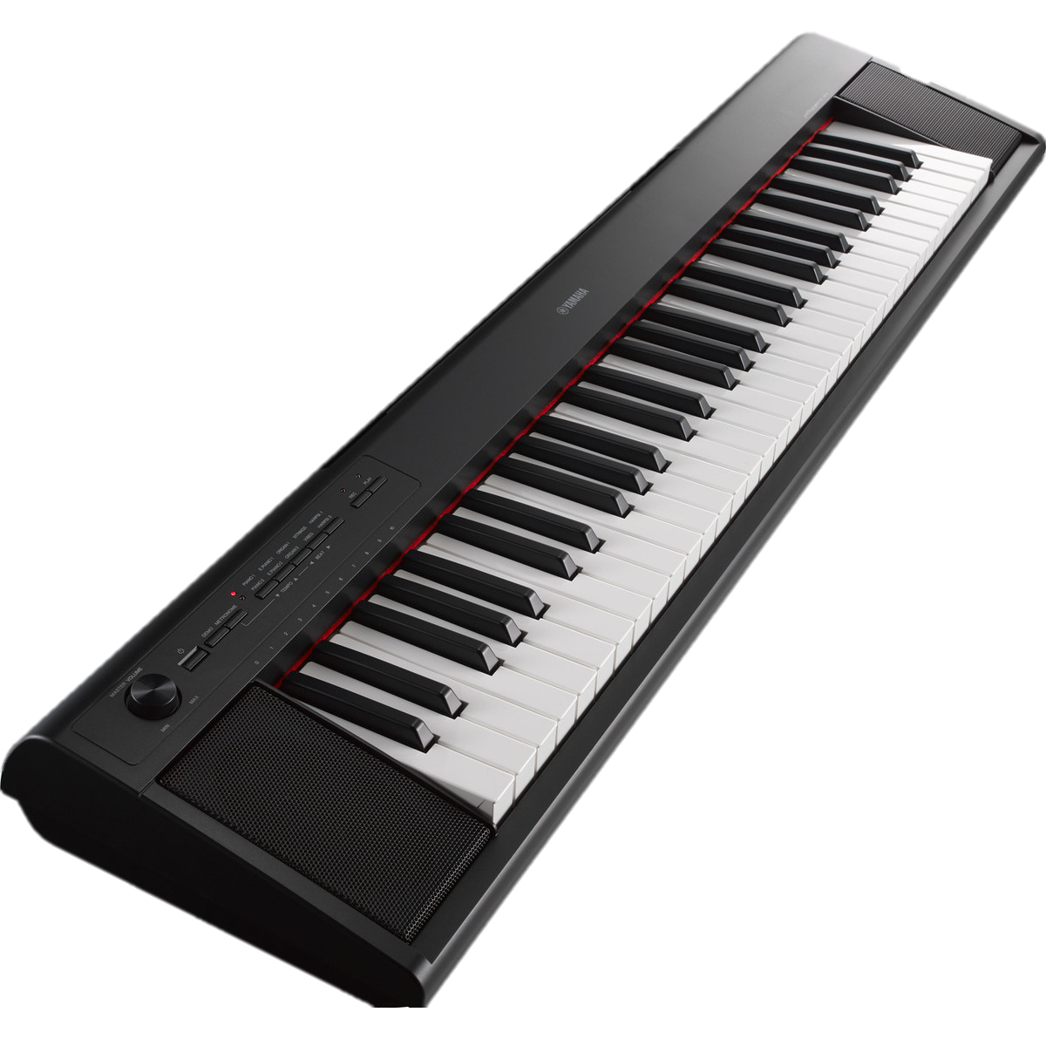
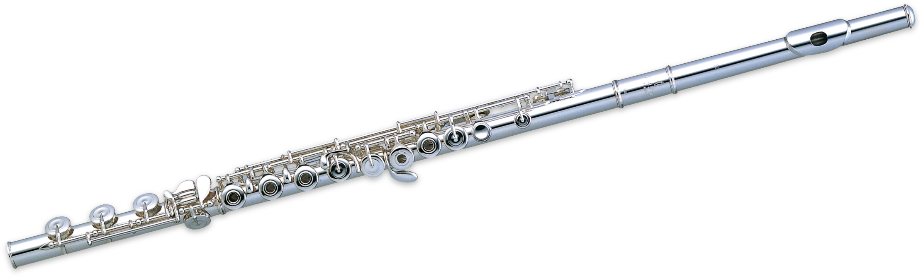
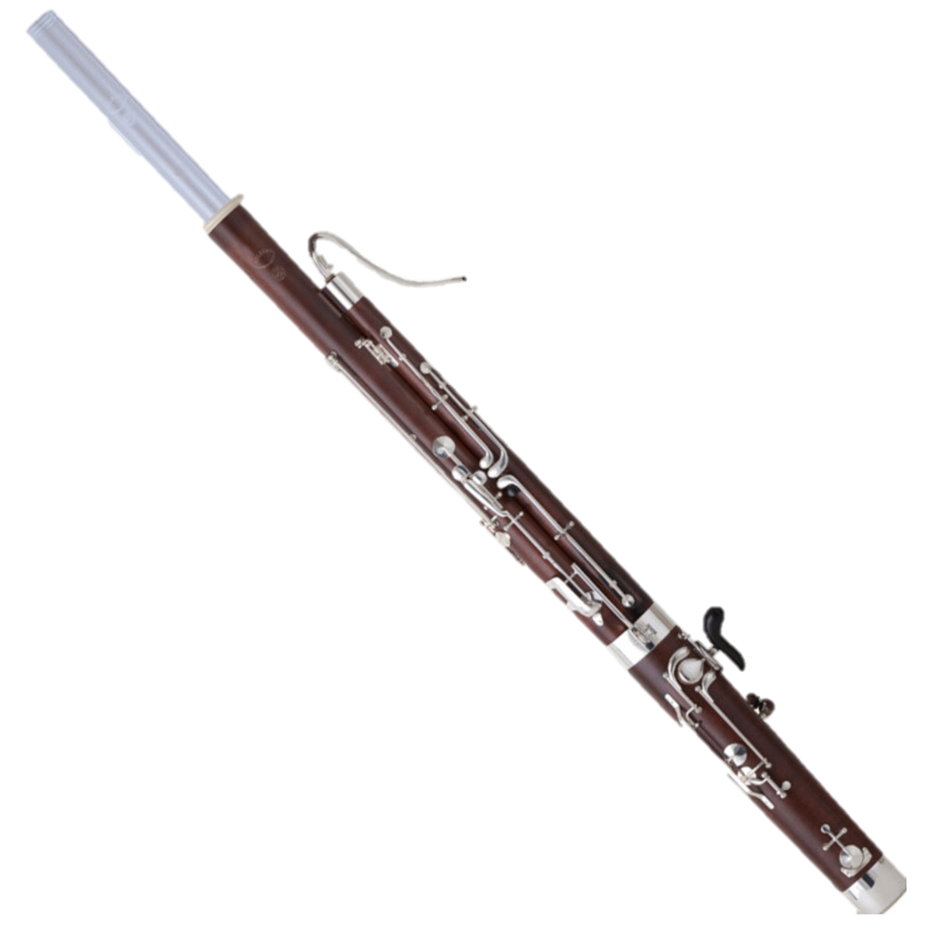
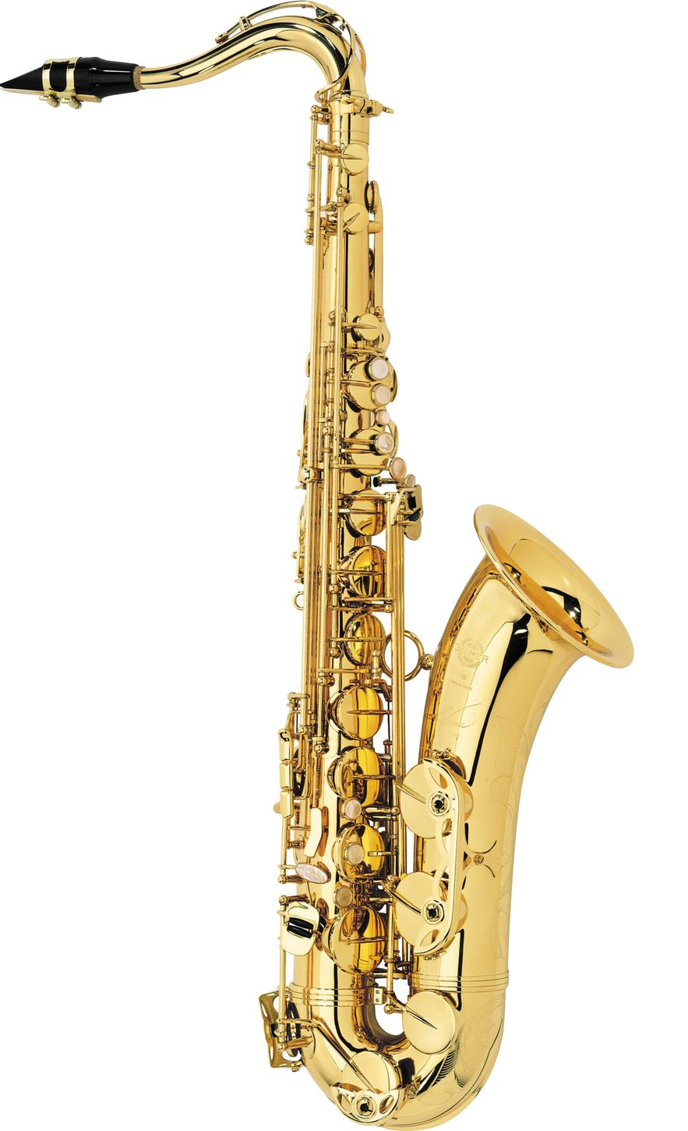
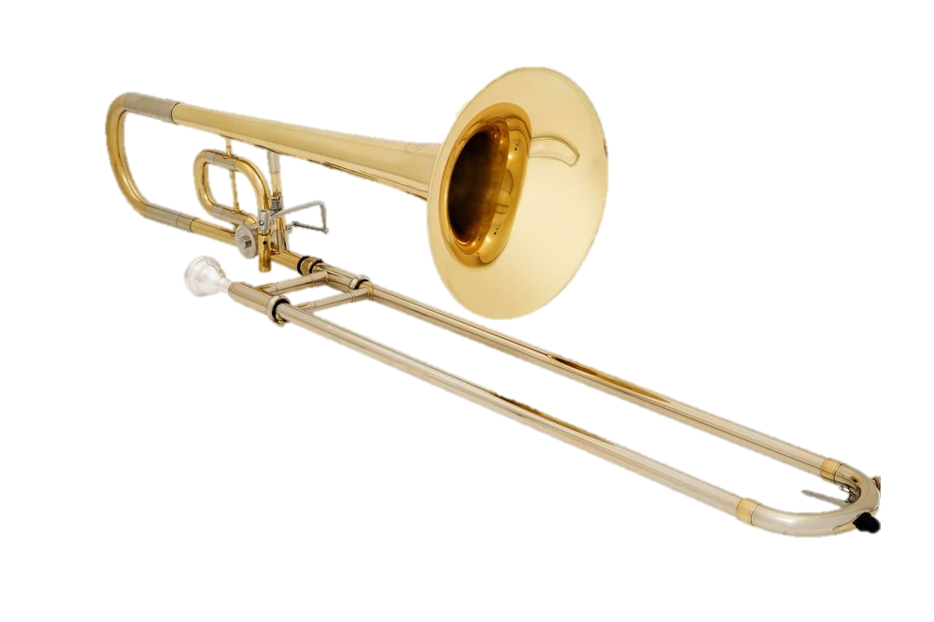
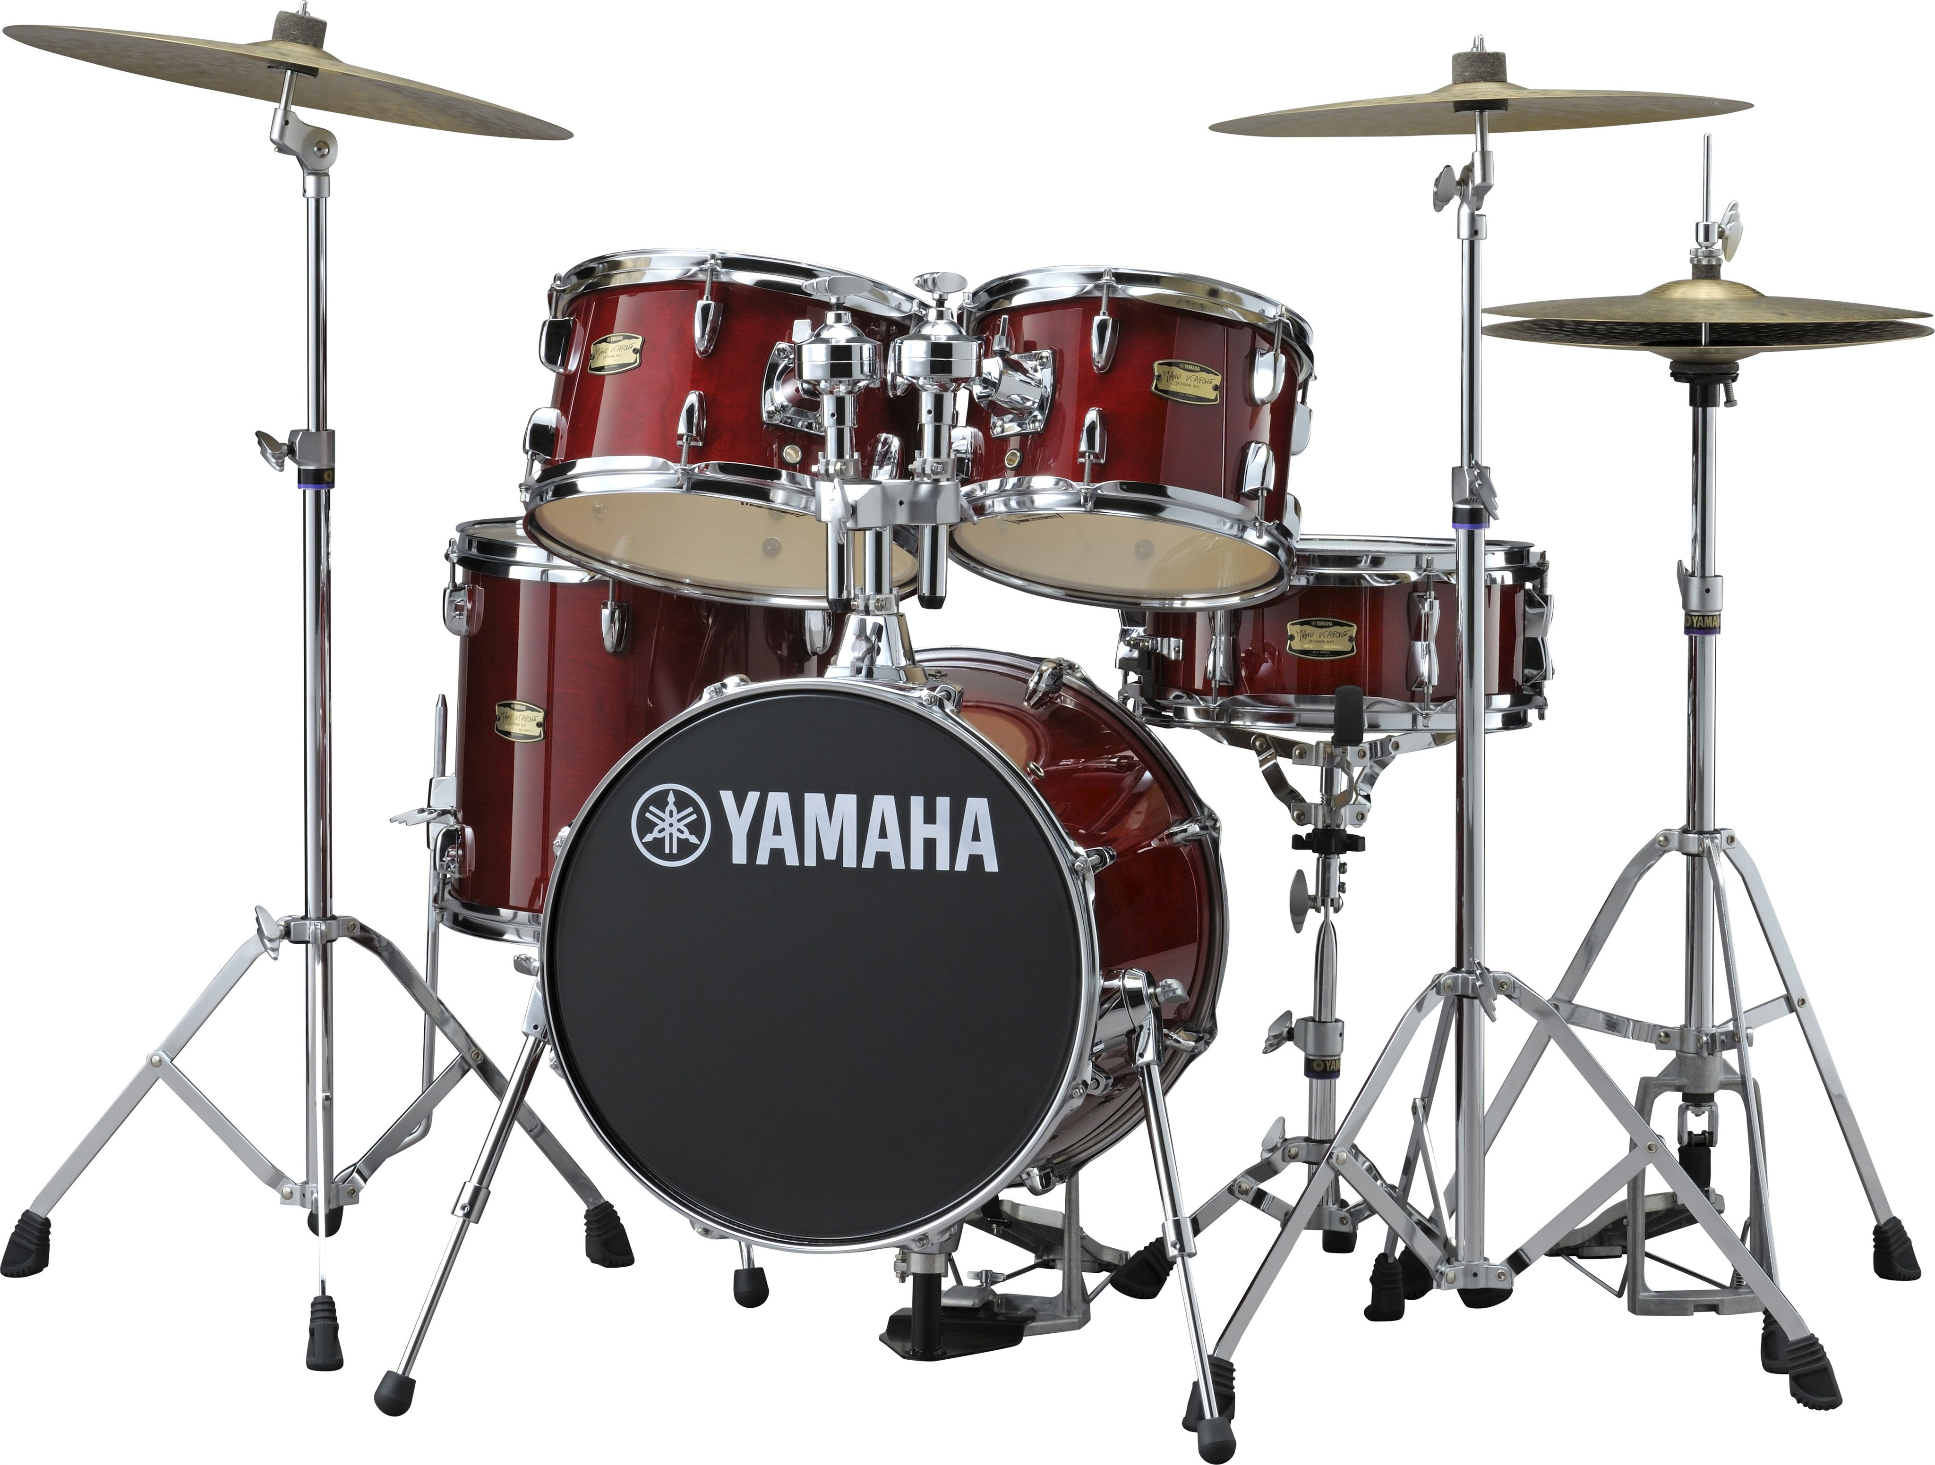
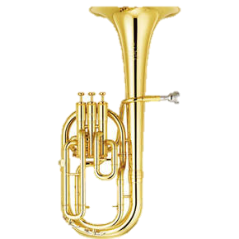

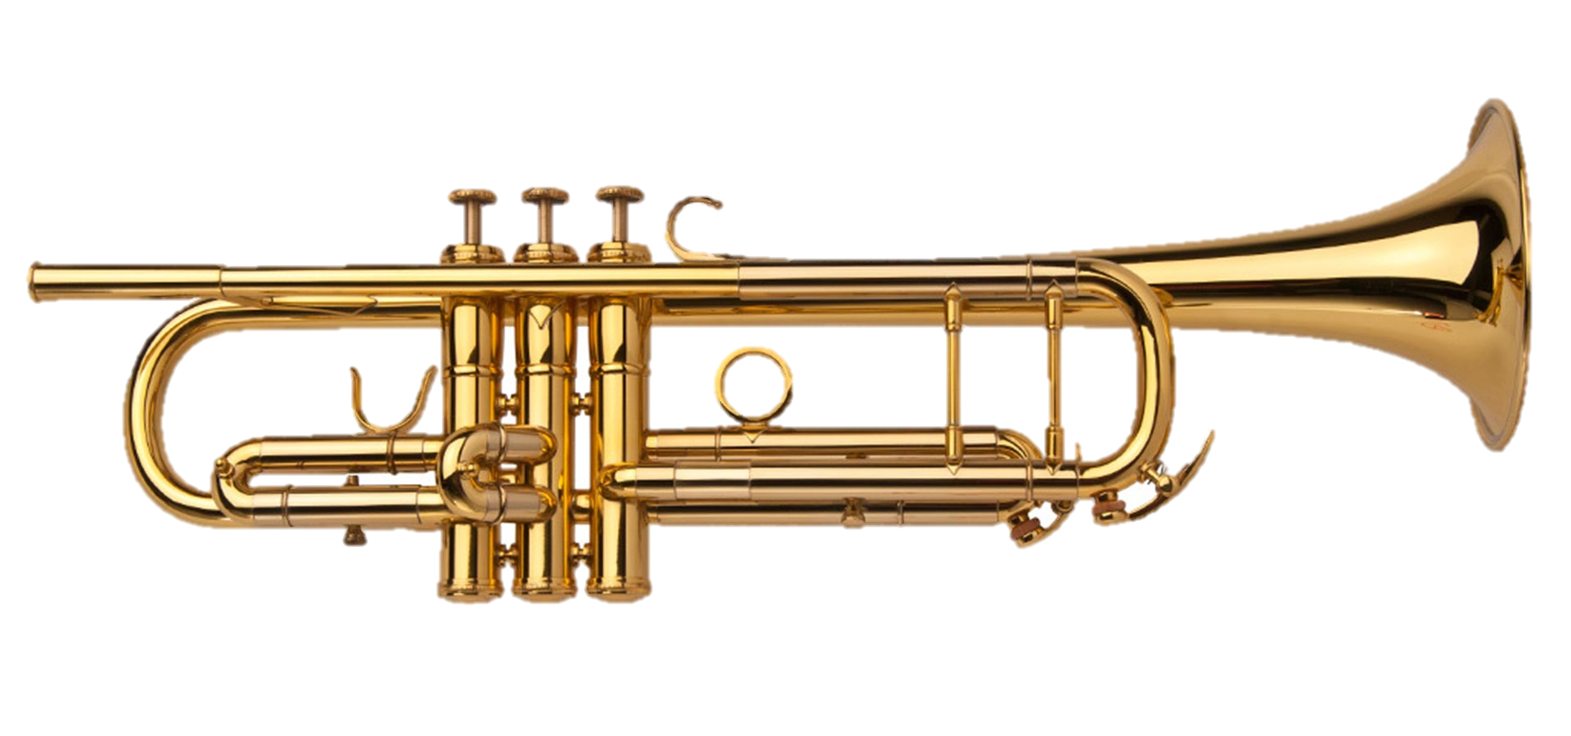
Music lessons at Ludlow
Instruments include:
Southampton Music Service (SMS) can provide instrumental lessons, at a cost, for any students who wish to learn an instrument. Lessons take place in school. Students will be allocated a 20 minute lesson (group or individual).
A minimum of 33 lessons per academic year will be provided. These take place in the afternoons.

Slide 20
Communication
Teachers work hard to build positive relationships with parents/carers. They aim to speak to you on the playground to celebrate individual successes and let you know when things are not going well.
If you have any worries, concerns or questions, talking to the class teacher at the end of the day on the playground should be your first port of call as it is often easier to support you and resolve any issues face-to-face.
Please also use Parentmail to check for any updates from the school

Slide 21
Thank You!
Please speak to a member of staff if you wish to speak in more detail about your child. Also, if your child has any medical needs then you will be sent a medical healthcare plan to complete via parentmail.
See you on Thursday 3rdh September!

